Slide 1
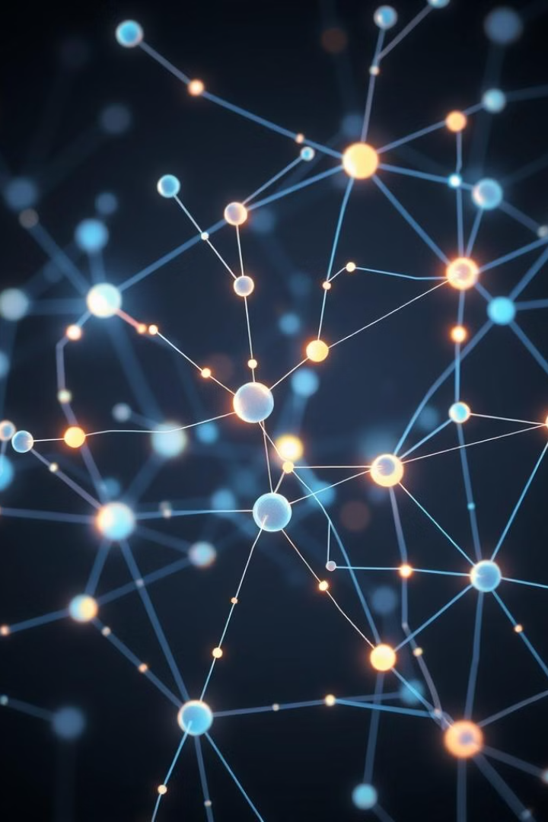
Neural Networks
Neural networks are powerful computational models inspired by the human brain. They excel at learning complex patterns from data.

Slide 2
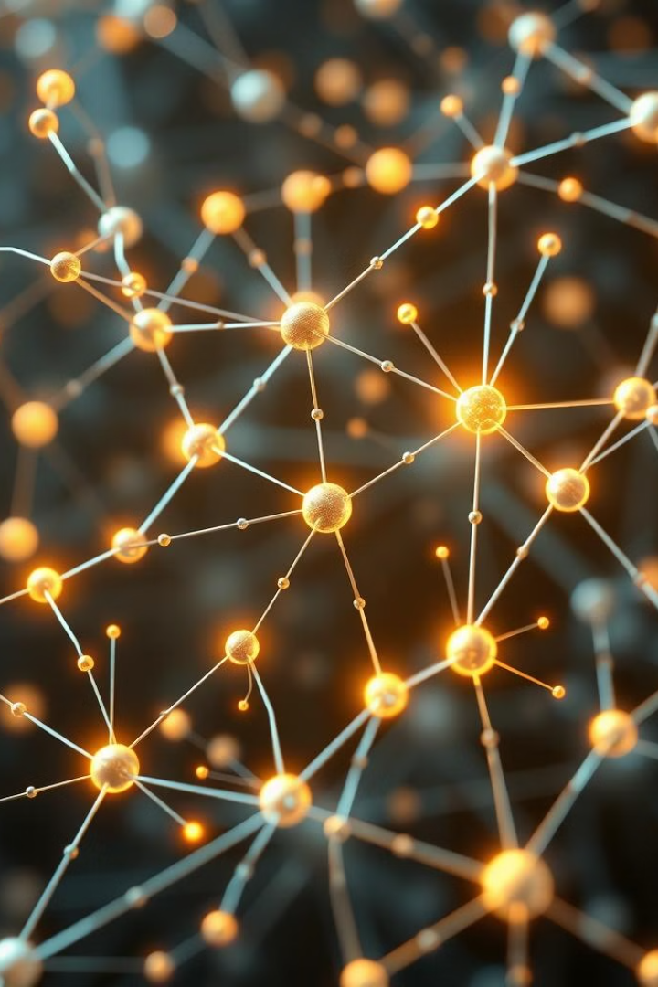
What are Neural Networks?
Biologically Inspired
Learning from Data
Neural networks mimic the structure and function of biological neurons.
They learn to recognize patterns by adjusting the strength of connections between neurons.
Powerful Tools
Used in diverse fields like image recognition and natural language processing.

Slide 3
Basic Architecture
Input Layer
Hidden Layers
Output Layer
Receives initial data, like pixels in an image.
Process the data, extracting features and patterns.
Produces the final result, like a classification.

Slide 4
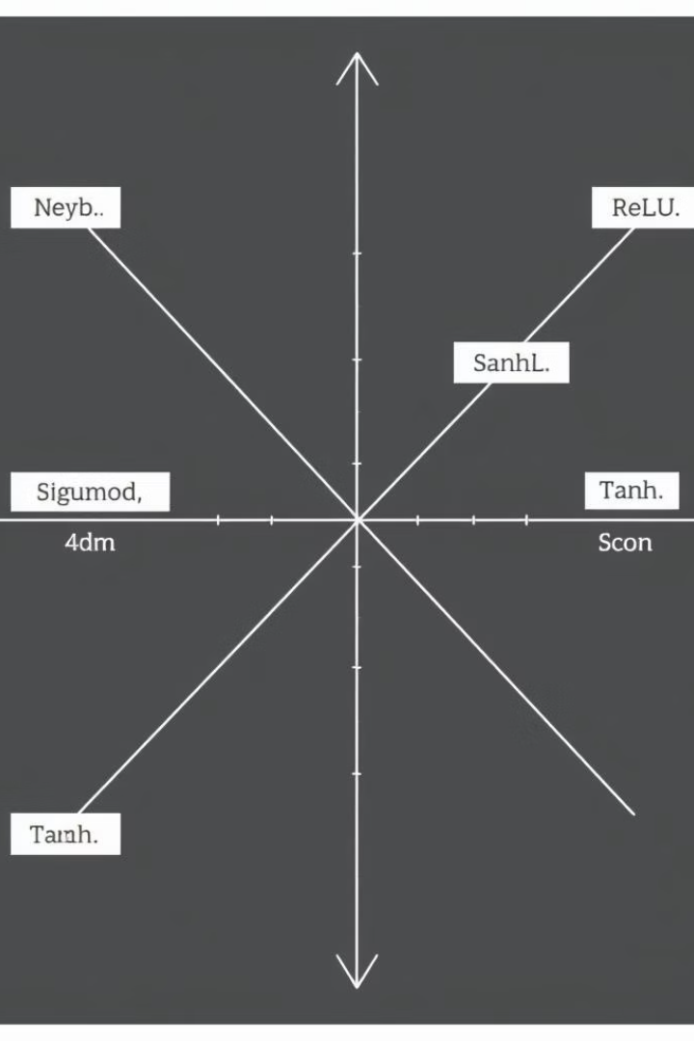
Activation Functions
1
Sigmoid
2
ReLU (Rectified Linear Unit)
Outputs values between 0 and 1, often used for binary classification.
Outputs the input if positive, zero otherwise. Commonly used in hidden layers.
3
Tanh (Hyperbolic Tangent)
Outputs values between -1 and 1. Often preferred over sigmoid.

Slide 5
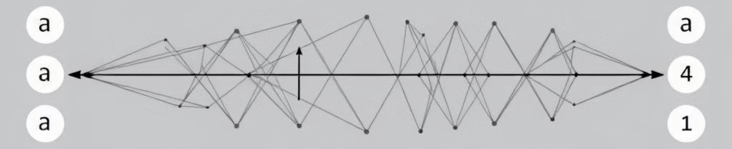
Feedforward Neural Networks
1
2
3
Input
Processing
Output
Data enters the network.
Data flows through hidden layers.
Network produces a result.

Slide 6
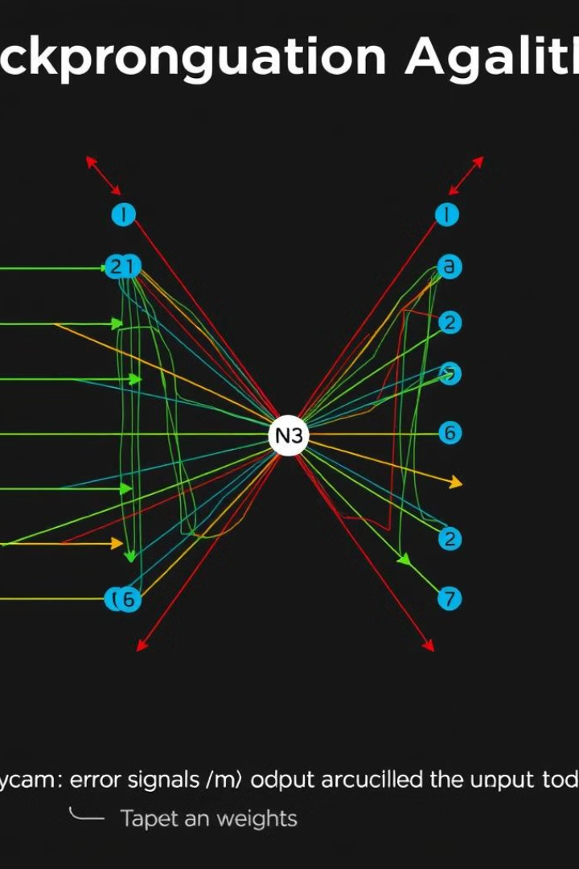
Backpropagation Algorithm
Backpropagation calculates the error at the output layer. This error is then propagated back through the network. It adjusts the weights to improve accuracy.

Slide 7
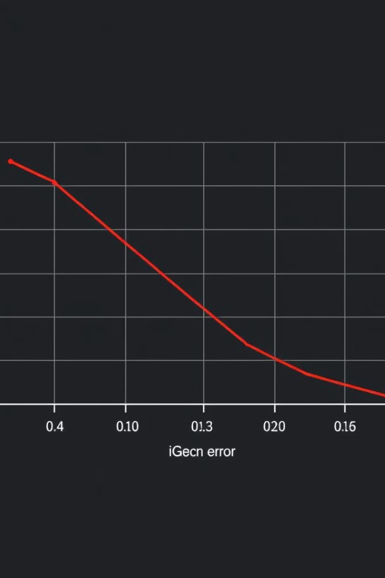



Training Neural Networks
Data Preparation
Clean and format data for training.
Training Process
Feed data to the network, adjust weights.
Validation
Test the network's performance.

Slide 8
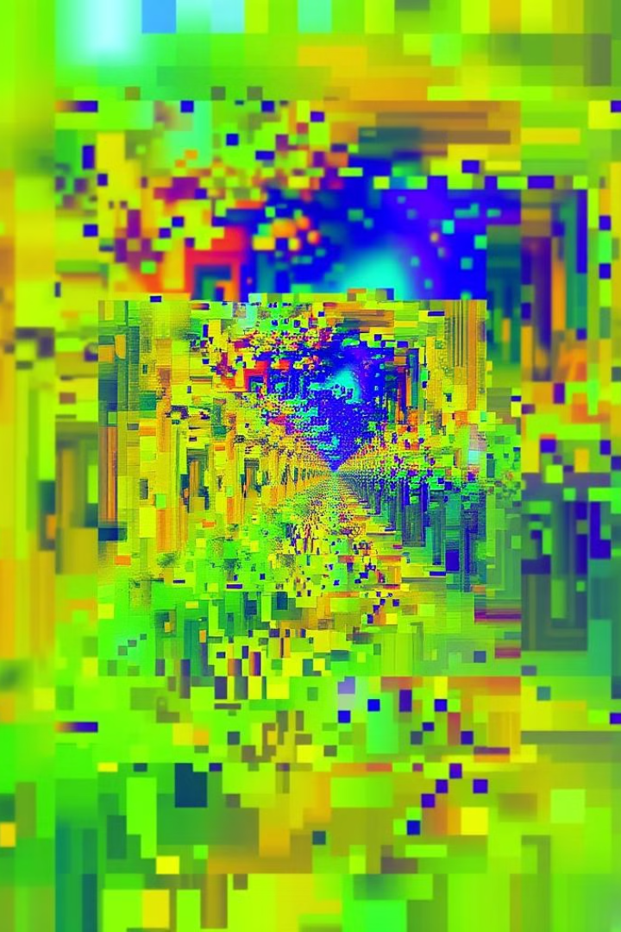
Convolutional Neural Networks
CNNs are specialized for processing grid-like data, like images. They use convolutional layers to detect features like edges and textures.

Slide 9

Recurrent Neural Networks
RNNs process sequential data like text and time series. They have a memory component that allows them to learn from past inputs.

Slide 10
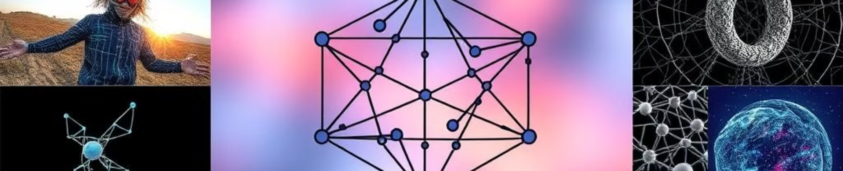



Applications of Neural Networks
Image Recognition
Natural Language Processing
Robotics
Identifying objects and faces in images.
Understanding and generating human language.
Controlling robots and enabling autonomous navigation.

